Slide 1
Adapting to the underwater world
Module OT1
Ocean Diver

Slide 2
Module content
Understanding air and water pressure and the physical effects on the diver in the underwater environment
Effects of depth and pressure
Snorkelling equipment
Scuba equipment
Buoyancy
Thermal protection

Slide 3
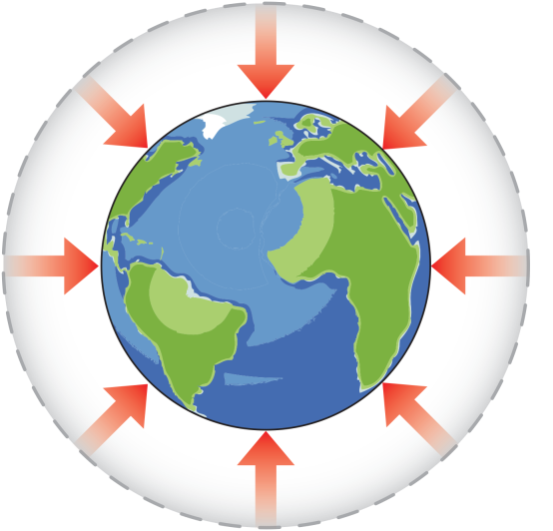
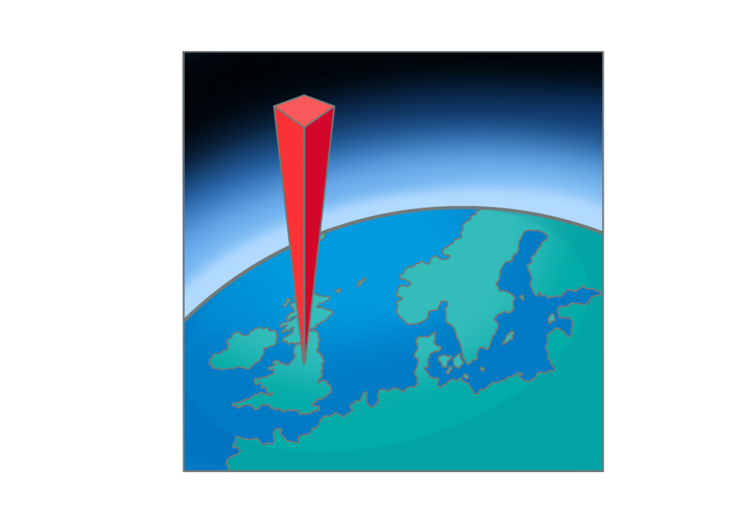
Air pressure
Air
Compressible gas
Surrounds the Earth
Exerts force in all directions
Atmospheric pressure
What is atmospheric pressure?
1kg/cm² = 1 bar
1 square cm
1 bar pressure at the surface

Slide 4
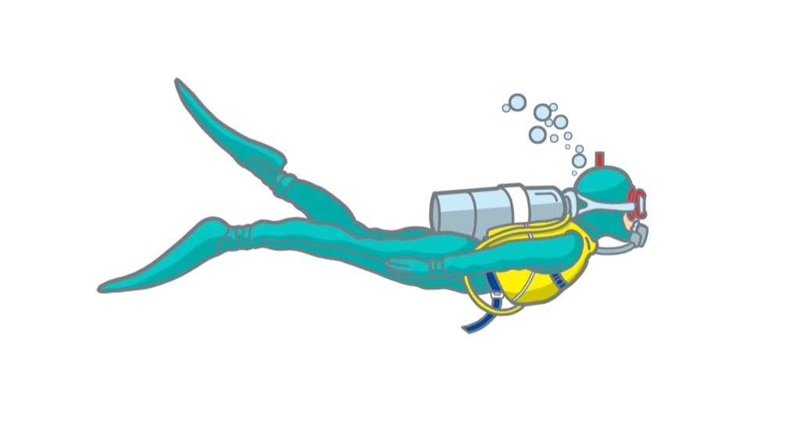
Water pressure
10,000 metres
AIR
Sea surface = 1 Bar
Water
Non-compressible liquid
Exerts force in directions
Weight of water exerts a pressure of one bar for every 10m of depth
Absolute pressure
Water (or gauge) pressure + atmospheric pressure
at 10m depth, absolute pressure = two bar
WATER
10 metres = 1 Bar
10m
Absolute pressure = 2 Bar
20m
Pressure = 3 Bar
30m
Pressure = 4 Bar

Slide 5
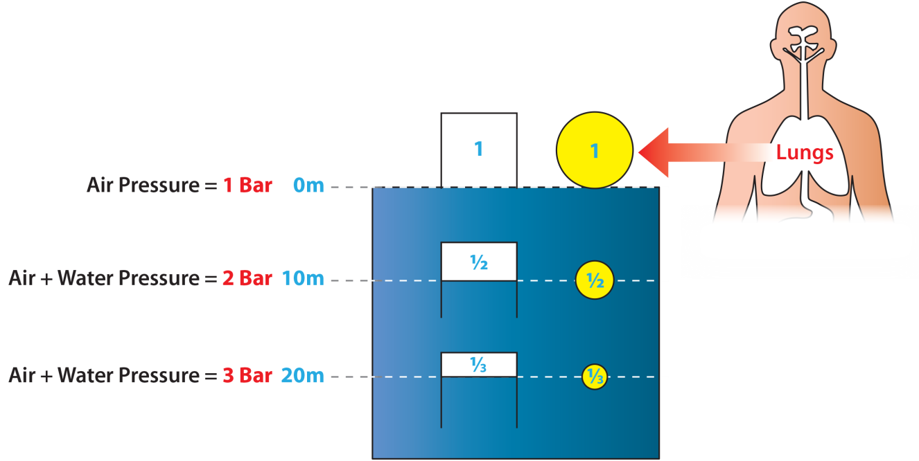
Depth and pressure
Effect of pressure on an air space
As pressure increases, volume decreases
As pressure decreases, volume increases
Impact on divers
Lungs
Diving equipment

Slide 6
Quiz 1
A diver is at a depth of 15m; what is the water pressure?
1.5 bar
What is the absolute pressure?
2.5 bar
The diver now descends to 25m; what is the absolute pressure?
3.5 bar

Slide 7
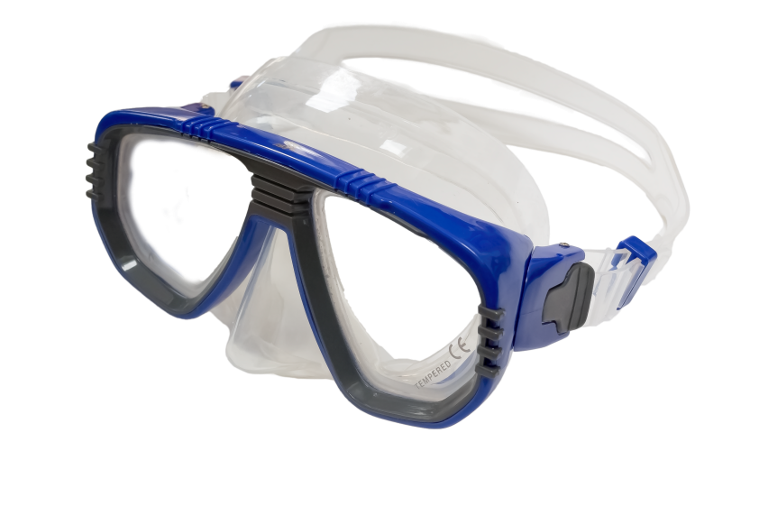
Snorkelling equipment – mask
Allows underwater vision
Features
Rigid frame
Tempered glass
Prescription lenses, if needed
Flexible seal or ‘skirt’
Nose pocket
Adjustable strap
Fit
Care
Rinse in fresh water
Dry before storing
Flexible seal
Adjustable strap
Tempered
glass
Frame
Nose pocket

Slide 8
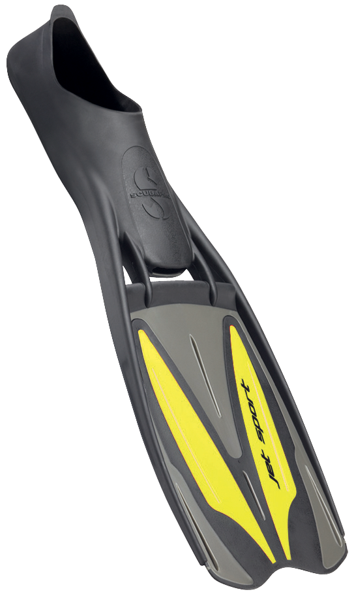
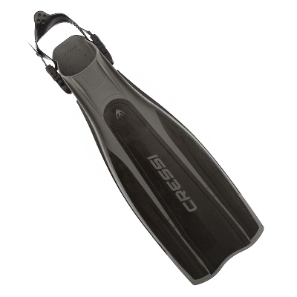
Snorkelling equipment – fins
Give underwater propulsion
Features
Two basic styles
Flexible blade
Stiffening ridges
Shaped to maximise efficiency
Fit
Comfortable foot pocket
Care
Rinse in fresh water
Dry before storing
Shoe fin
Strap fin

Slide 9
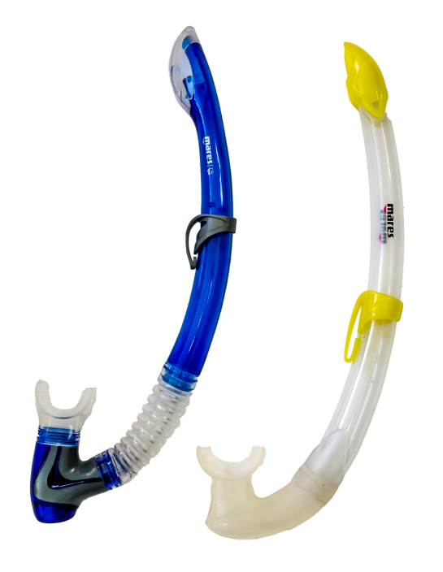
Snorkelling equipment – snorkel
Splash guard
Allows surface breathing
Features
Tube
40-45cm long
20mm diameter
Self-drain valves
Fit
Mouthpiece
Care
Rinse in fresh water
Dry before storing
Drain valve

Slide 10
Breathing underwater
Snorkelling Equipment
SCUBA Equipment
Air
1 Bar
Air
Pressure
1 bar
Air 1 Bar
Snorkelling equipment
Diver breathes gas at atmospheric pressure
Lungs are compressed on descent
Scuba equipment
Diver breathes gas at surrounding pressure
Lungs are not compressed on descent
Depth
0m
Air + Water
Pressure
2 bar
Air 2 Bar
1/2
10m
Air + Water
Pressure
3 bar
Air 3 Bar
20m
1/3

Slide 11
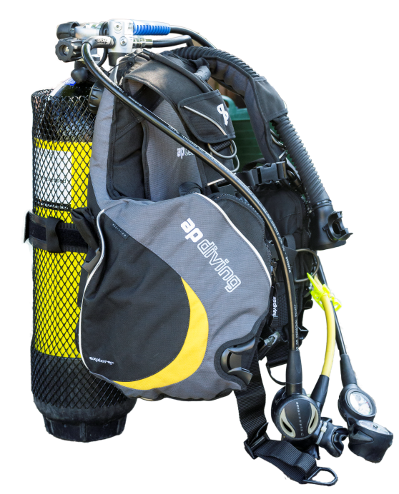
Scuba equipment
Scuba
Self
Contained
Underwater
Breathing
Apparatus
Components
Cylinder
Buoyancy compensator
Regulator

Slide 12
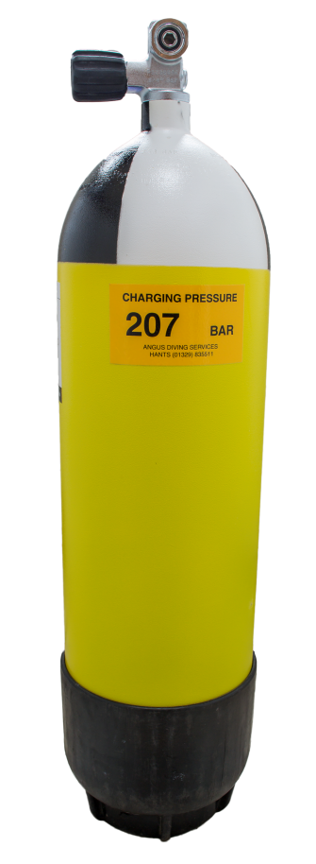
The cylinder
Features
Contains breathing gas at high pressure
Steel or aluminium
BS/EN standard; CE mark
Testing
Hydrostatic every 5 years
Visual every 2.5 years
Care
Rinse in fresh water
Dry before storing
Do not store empty

Slide 13
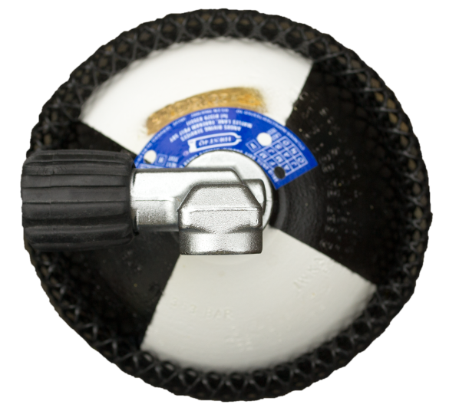
Cylinder markings
Breathing gases
Air (21% oxygen)
Nitrox (32% or 36% oxygen)
Key marks and labels
“Breathing Air” or “Nitrox” labels
Cylinder size
Working and test pressures
Test dates
Cylinders used for nitrox need periodic cleaning
BS/EN5045/7
12L
WP232
TP348
3/01
Cylinder size
Working Test
Pressures
Test
date

Slide 14
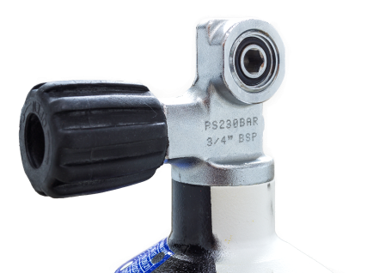
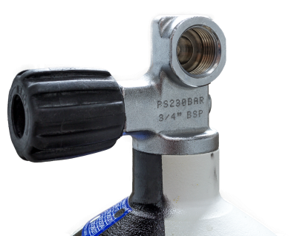
Pillar / crossflow valves
A-clamp (yoke)
232 bar cylinders (max)
DIN
232 - 300 bar cylinders
M26
Nitrox cylinders
A - clamp
DIN

Slide 15
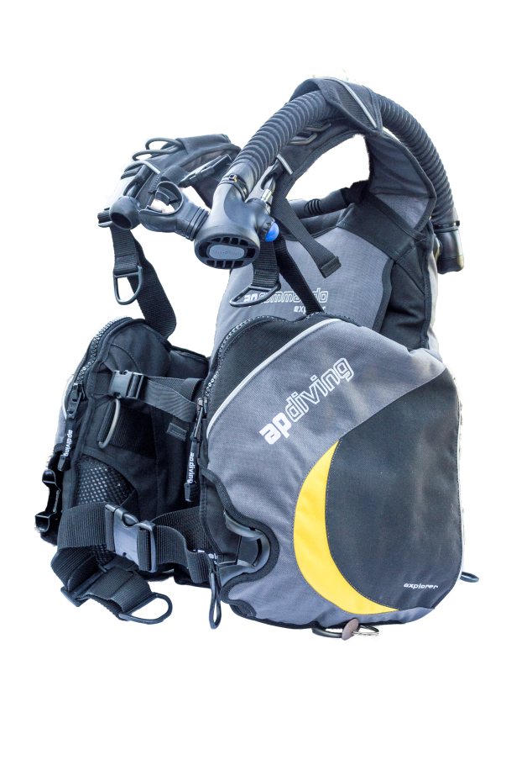
Buoyancy compensator
Direct feed
Pull dump
Supports the cylinder
Buoyancy adjustment
Features
Gas bladder
Direct feed
Oral inflator
Dump valves
Over-pressure relief valve
Care
Rinse in fresh water (inside and out)
Dry before storing slightly inflated
Service to manufacturer recommendations
Oral inflator
Cylinder
support
Push dump
Integrated bladder

Slide 16
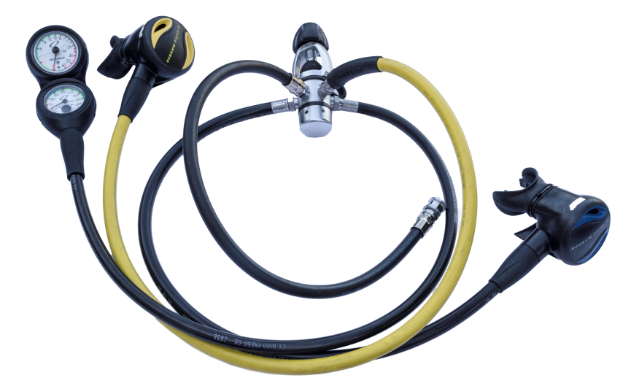
Regulator
First Stage
Delivers breathing gas
Features
First and second stages
Hoses
Alternative supply (AS)
Contents/pressure gauge
Types
Cold water (less than 10ºC)
Nitrox
Care
Rinse in fresh water
Dry before storing
Service to manufacturer recommendations
AS
Second Stage
Contents gauge
Direct feed hose

Slide 17
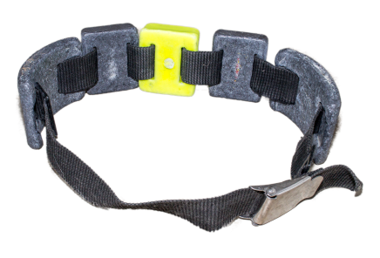
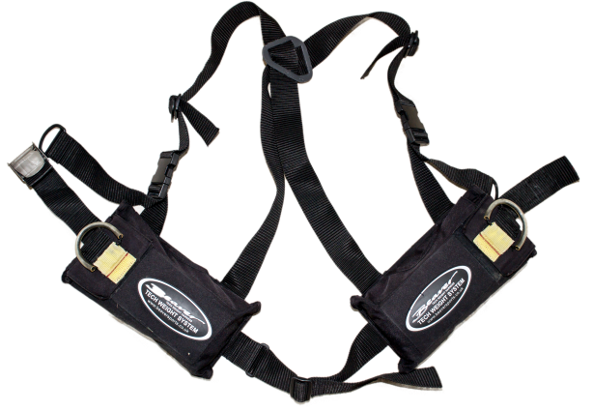
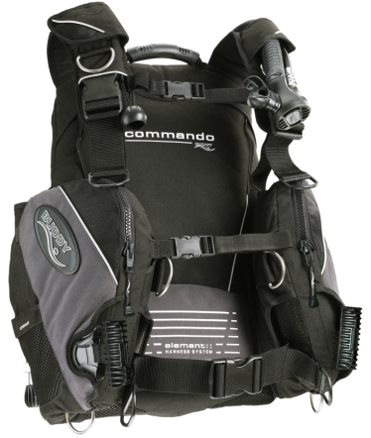
Weights
Weight belt
Types
Weight belts
Weight harness
Integrated weights
Quick-release mechanisms
Trim
Care
Wash in fresh water
Dry before storing
Weight harness
Integrated
Weight BC

Slide 18
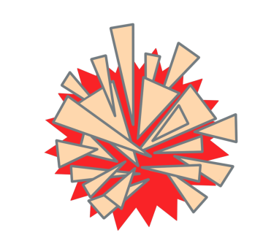
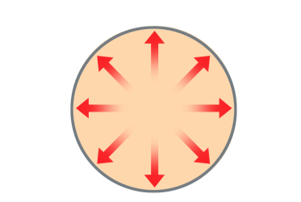
Using scuba equipment
Air 1 Bar
Warning
Scuba delivers breathing gas at ambient pressure
Breathe normally at all times
Or gas in lungs will expand on ascent resulting in damage
Breathe normally on ascent
Depth
Pressure
0m
1 bar
Air 2 Bar
Air 2 Bar
10m
2 bar
Air 3 Bar
Air 3 Bar
20m
3 bar

Slide 19
Buoyancy
Water displacement
Occurs when an object is placed in water
Creates an upwards force equal to the weight of water displaced
Density is relevant
Objects sink when they are heavier than water displaced
Objects float when they are lighter than water displaced
0.5 kg
Displacement
1.25 kg
1 kg
1 kg
Float
Sink
Upwards force equal to weight of displaced water

Slide 20
Buoyancy and divers
Neutral buoyancy
Weightless state
Reduces physical effort
Positive buoyancy
Too light
Physically tiring
Uncontrolled upward movement
Negative buoyancy
Too heavy
Physically tiring
Risk of going too deep
Self or marine life damaged
Sinking on surface

Slide 21
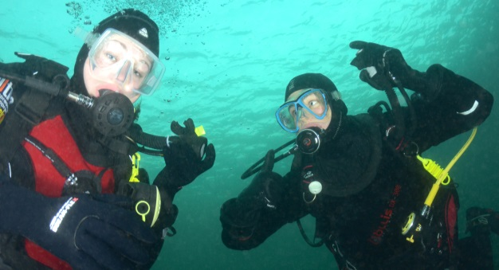
Buoyancy in practice
Descent
Diving suits + scuba kit normally cause positive buoyancy at surface
Add weight to achieve neutral buoyancy
During dive
Compensate with BC or drysuit
Fine tuning with lungs
Ascent
Gas will expand
Controlled dumping of air equalises diver’s buoyancy
Buoyancy check – correct weighting

Slide 22
Body temperature and heat loss
Core body temperature
Maintained at 37°C
Heat loss
Caused by cooler surroundings
Blood supply to periphery is restricted to reduce heat loss
Signs and symptoms
Blue/numb extremities
Shivering
Hypothermia

Slide 23
Heat loss (2)
In water
Heat loss is 25 times faster than in air
Water temperature determines insulation required
End the dive if getting cold

Slide 24
Insulation – wet and semi-dry suits
Features
Comfortable close fit
One or two piece
Semi-dry suits have seals to reduce flushing
Hood and gloves
Boots with strap fins
Care
Wash in fresh water
Dry before storing

Slide 25
Insulation – drysuits
Neoprene
Membrane
Types
Neoprene
Membrane
Features
Comfortable fit
Seals to prevent water entering
Waterproof entry zip
Under suits
Hood and gloves
Care
Wash in fresh water
Dry before storing
Dust seals, lubricate zip

Slide 26
Quiz 2
What are three main parts of a scuba set?
Cylinder, BC and regulator
When breathing from scuba, equipment what must you never do?
Hold your breath
While underwater, divers should maintain, what type of buoyancy?
Neutral

Slide 27
Understand the significance of the physical effects of the diving environment
Module OT1
Effects of depth and pressure
Snorkelling equipment
Scuba equipment
Buoyancy
Thermal protection

